Slide 2
THE DISCIPLES RELATIONSHIP:
TO HIMSELF
An Athlete
A Soldier
TO HIS LORD
The Potter and the Clay
The Vine and the Branches
A Child of God
TO HIS BRETHREN
A Member of the Body
“My Brother’s Keeper”
A Servant
TO THE WORLD
Strangers & Pilgrims
Salt & Light
An Apologist
Fishers of Men

Slide 3
THE DISCIPLES RELATIONSHIP TO THE WORLD:
Strangers & Pilgrims
We are different from the world
Salt & Light
We are an influence in the world
An Apologist
We are ready to explain our hope with the world
Fishers of Men
We are working to help those lost in the world

Slide 4
LESSON 11: Salt & Light The Disciple’s Influence
“You are the salt of the earth… You are the light of the world…” (Matt. 5:13,14)

Slide 5
Salt and Light – Lesson 11 Outline
Intro: A corrupt and dark world
Salt
A Preservative
Salt Gives Flavor
Salt Creates Thirst
Light
Light Reveals and Illuminates
Light Drives Away Darkness
Light Gives Guidance
Light Warms and Comforts
Light Draws Those Out of the Darkness
Maintaining Our Influence

Slide 6
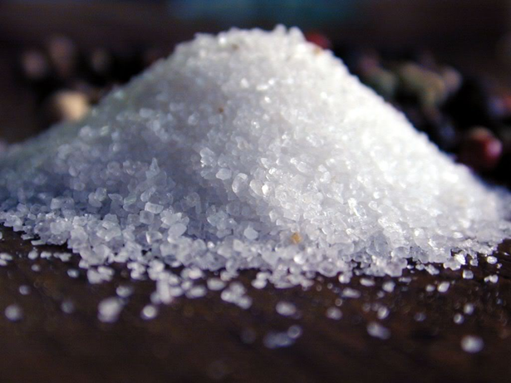
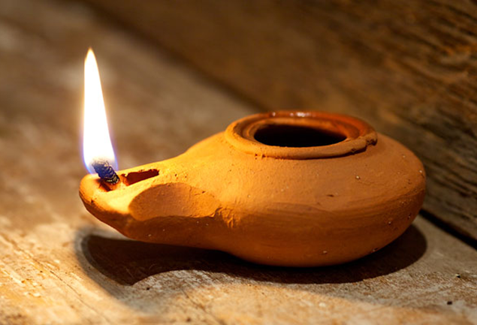
Salt and Light (Matt. 5:13-14)
“You are the salt of the earth; but if the salt has
become tasteless, how can it be made salty again?
It is no longer good for anything, except to be
thrown out and trampled under foot by men. You
are the light of the world. A city set on a hill cannot be hidden; nor does anyone light a lamp and put it
under a basket, but on the lampstand, and it
gives light to all who are in the house. Let your
light shine before men in such a way that they
may see your good works, and glorify your
Father who is in heaven.”

Slide 7
A Corrupt and Dark World
2Pet. 1:4 “For by these He has granted to us His precious and magnificent promises, so that by them you may become partakers of the divine nature, having escaped the corruption that is in the world by lust.”
1John 2:15-17 “…all that is in the world, the lust of the flesh and the lust of the eyes and the boastful pride of life, is not from the Father, but is from the world…” (vs. 16)

Slide 8
A Corrupt and Dark World
Eph. 4:22-23 “…you lay aside the old self, which is being corrupted in accordance with the lusts of deceit, and that you be renewed in the spirit of your mind, and put on the new self…”
Eph. 5:8 “for you were formerly darkness, but now you are Light in the Lord…”
Eph. 5:11 “Do not participate in the unfruitful deeds of darkness, but instead even expose them…”

Slide 9
A Corrupt and Dark World
1Pet. 2:9 “But you are a chosen race, a royal priesthood, a holy nation, a people for God’s own possession, so that you may proclaim the excellencies of Him who has called you out of darkness into His marvelous light.”
1John 1:5 “…God is Light, and in Him there is no darkness at all.”
John 3:19 “…the Light has come into the world, and men loved the darkness rather than the Light, for their deeds were evil.”

Slide 10
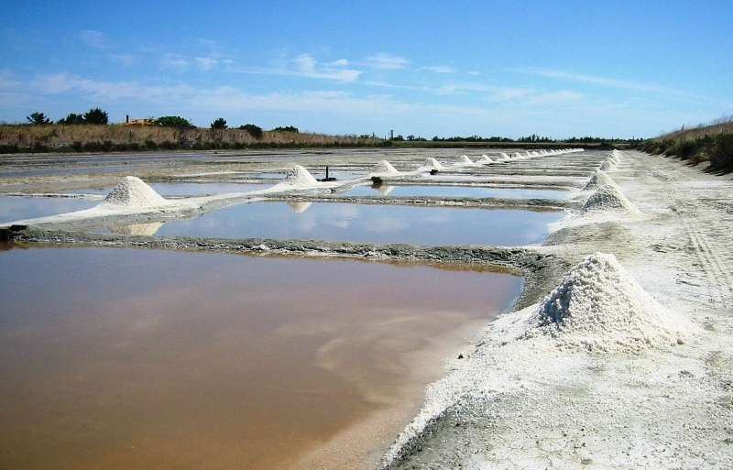
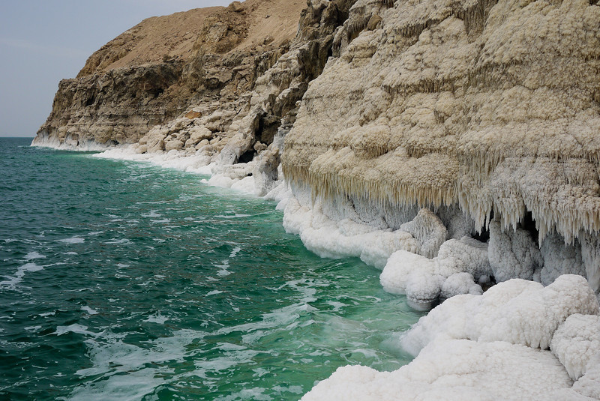
You are Salt
Ezek. 47:11 “But its swamps and marshes will not become fresh; they will be left for salt”

Slide 11
You are Salt
Mentions of “salt” in the bible:
Used with offerings (Lev. 2:13; Ezek. 43:24)
Newborn baby to be rubbed with salt (Ezek. 16:4)
“covenant of salt” (Num. 18:19; 2Chr. 13:5)
Lot’s wife turned to “a pillar of salt” (Gen.19:26)
Figuratively used to describe barrenness and sterility (Deut. 29:23; Jer. 17:6)
Used to describe disciples of Jesus (Matt. 5:13)
Used to describe wholesome character and speech (Mark 9:50; Col. 4:6)

Slide 12
You are Salt – A Preservative
Salt is aseptic (free from contamination caused by harmful bacteria, etc.)
Salt was and can be used to store meat without refrigeration for extended periods of time
Matt. 5:13 “You are the salt of the earth; but if the salt has
become tasteless, how can it be made salty again? It is no longer good for anything, except to be thrown out and trampled under foot by men.”
Mark 9:50 “Salt is good; but if the salt becomes unsalty, with what will you make it salty again? Have salt in yourselves, and be at peace with one another.”

Slide 13
You are Salt – A Preservative
Gen. 18:16-19:29
“And the Lord said, “The outcry of Sodom and Gomorrah is indeed great, and their sin is exceedingly grave.”
Fifty righteous…forty-five…forty…thirty…twenty…ten…
“Up, take your wife and your two daughters who are here, or you will be swept away in the punishment of the city.”
“Escape for your life! Do not look behind you…”
“Then the Lord rained on Sodom and Gomorrah brimstone and fire…He overthrew those cities, and all the valley, and all the inhabitants…
“But his wife, from behind him, looked back, and she became a pillar of salt.”

Slide 14
You are Salt – Salt Gives Flavor
Salt enhances the taste of food
Col. 4:5-6 “Conduct yourselves with wisdom toward outsiders, making the most of the opportunity. Let your speech always be with grace, as though seasoned with salt, so that you will know how you should respond to each person.”

Slide 15
You are Salt – Salt Creates Thirst
“Some people create a spiritual thirst in others simply by the way they live” (author)
1Tim. 4:12 “Let no one look down on your youthfulness, but rather in speech, conduct, love, faith, and purity, show yourself an example of those who believe.”
Matt. 5:6 “Blessed are those who hunger and thirst for righteousness, for they shall be satisfied.”

Slide 16
You are Light
Matt. 5:14 “You are the light of the world. A city set on a hill cannot be hidden; nor does anyone light a lamp and put it under a basket, but on the lampstand, and it gives light to all who are in the house. Let your light shine before men in such a way that they may see your good works, and glorify your Father who is in heaven.”
God = Light (1John 1:5-10)
Jesus = Light (John 1:4-9; John 8:12)
Satan = Darkness (Act. 26:14-18; Col. 1:13)
We are of God; We are a light (Eph. 5:6-8)

